Slide 1

Aviation Academy Update
School Board Work Session
November 19, 2019

Slide 2
Agenda
Condition of existing facility
Timeline on lease negotiation
Relocation option

Slide 3
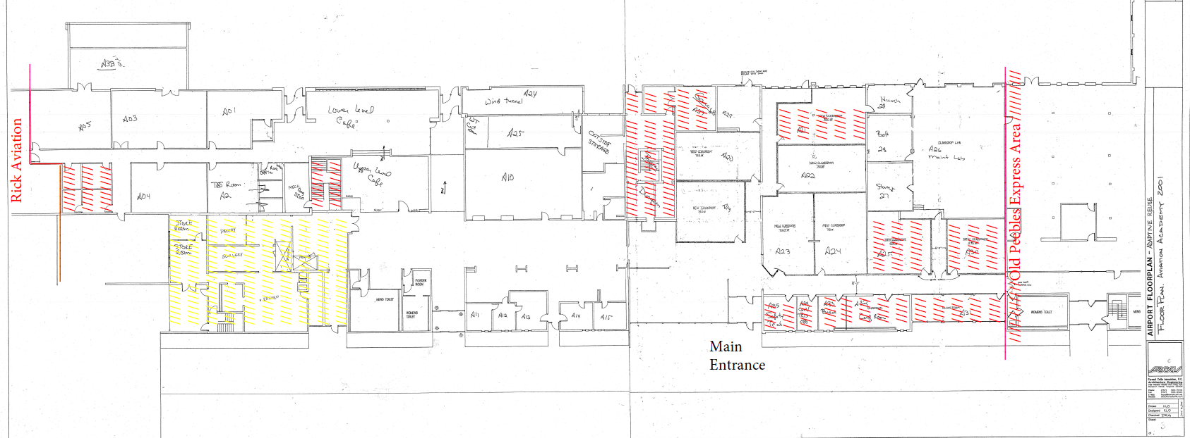
Existing Aviation Academy
Existing leased space
Red-hashed areas not currently used
Yellow-hashed area out of service in December

Slide 4
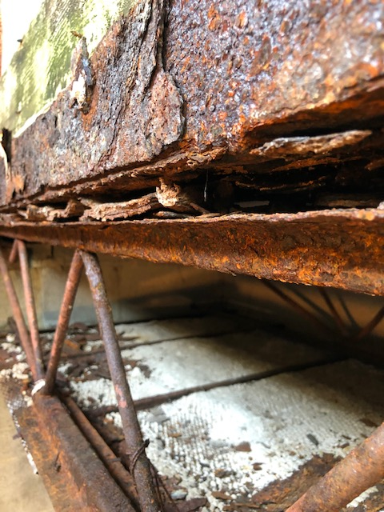
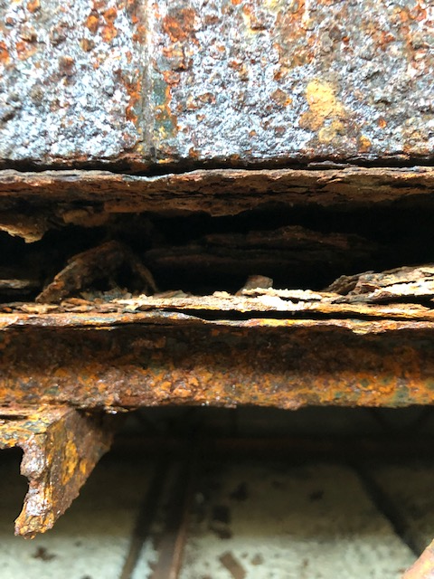
Aviation Academy - Roof

Slide 5
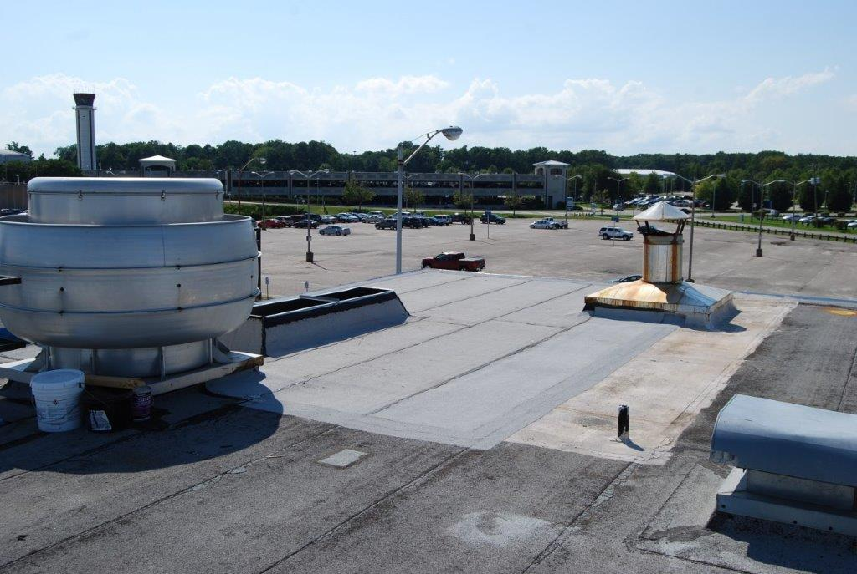
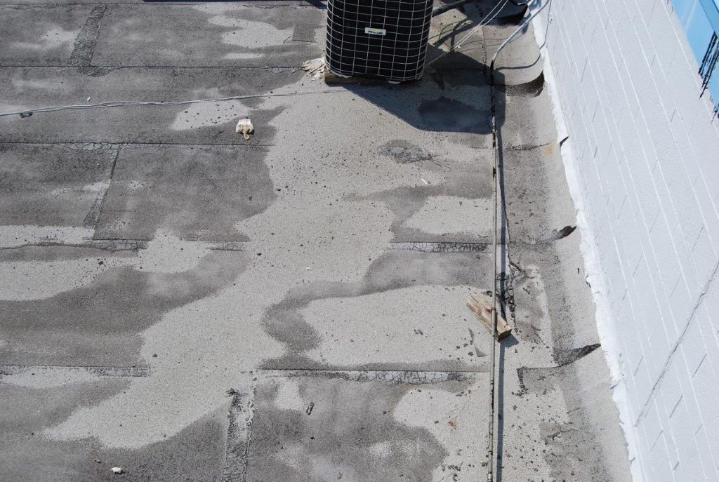
Aviation Academy - Roof
Notes:
You

Slide 6
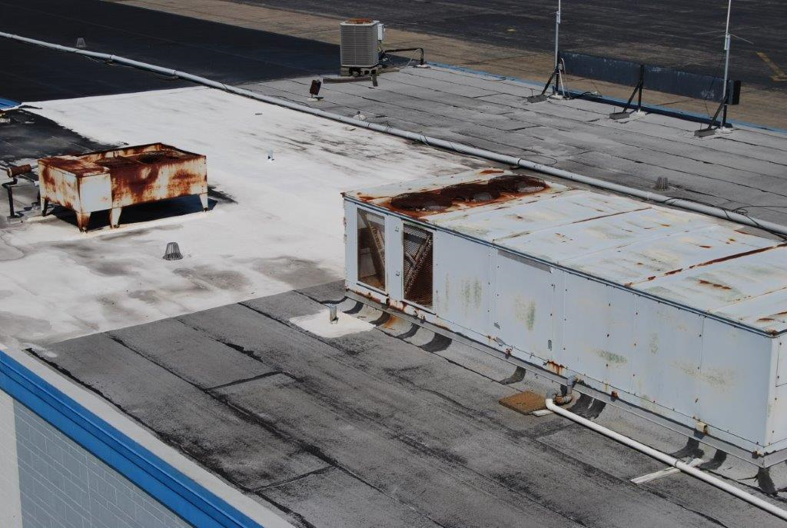
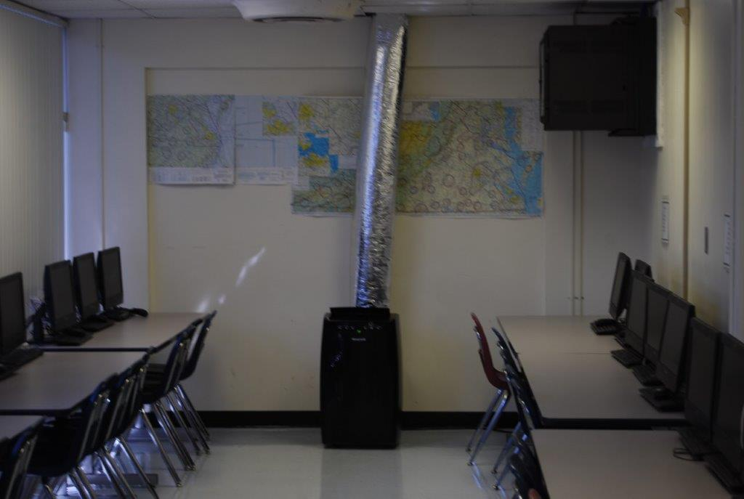
Aviation Academy - HVAC

Slide 7
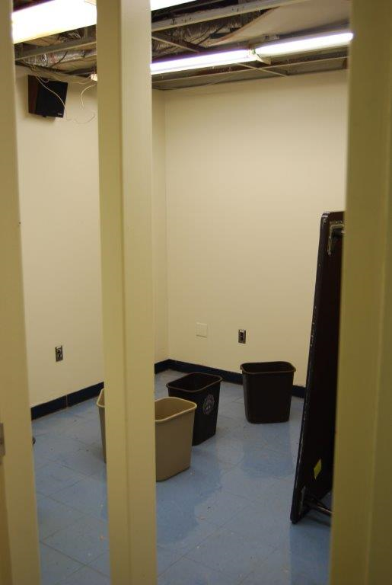
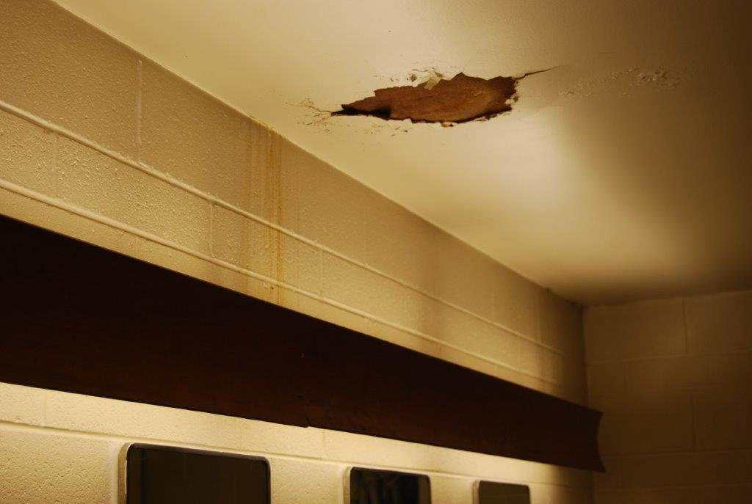
Aviation Academy - Ceiling

Slide 8
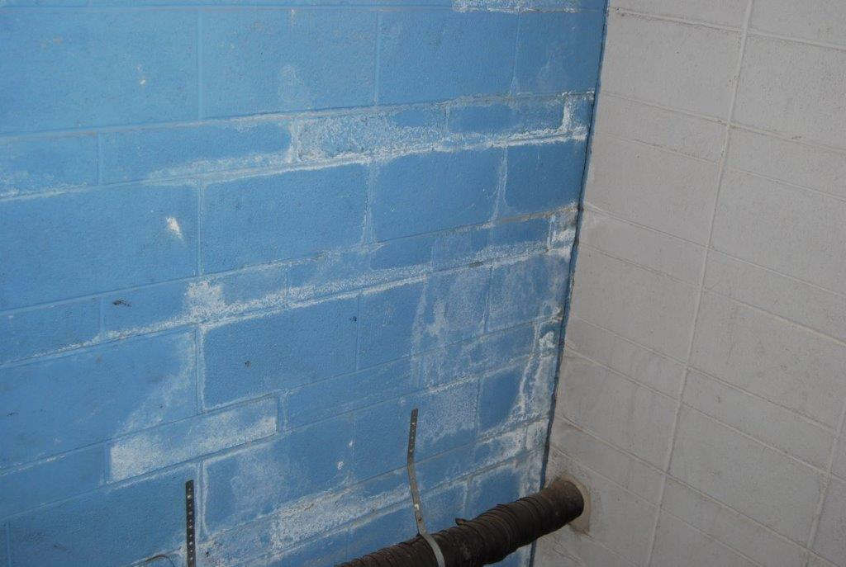
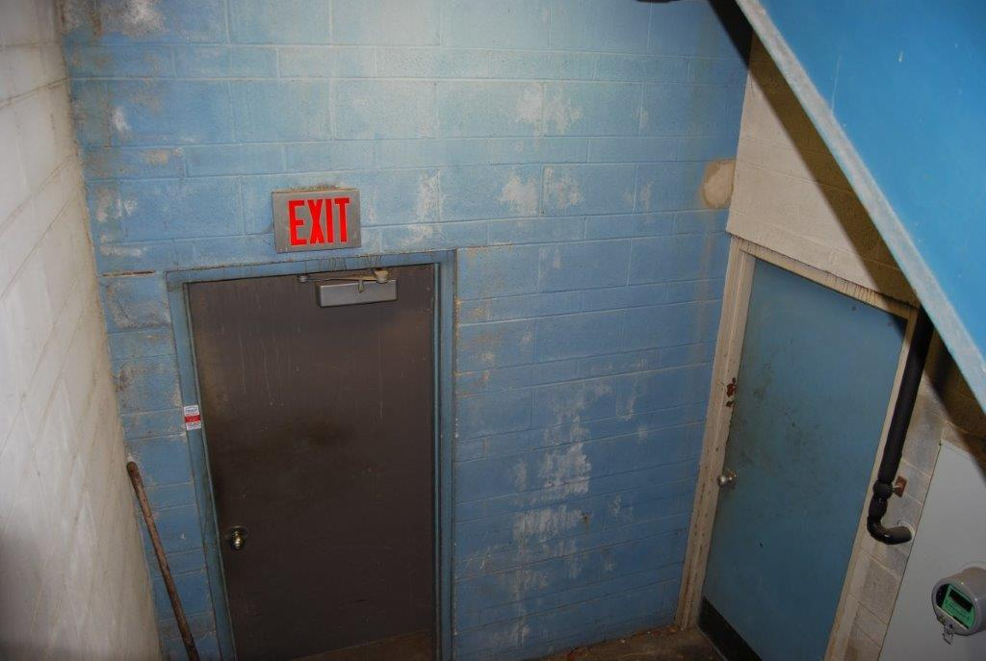
Evidence of Roof leaks

Slide 9
Cost considerations at airport facility
Maintenance costs in June FY2019
  HVAC cost $170K
  Roof cost $ 15K
  Abatement requirements $ 46K
Maintenance costs in FY2020 (July – Nov)
  Roof work $ 13K
  Remediation work $ 11K
  Portable HVAC units $ 61K
Maintenance costs (FY2009 – FY2018) $ 448K

Slide 10
Timeline on lease negotiation
May 2018 – Sept. 2019 – discussion of new lease for existing space
May 2018 – Sept. 2019 – discussion of new lease for existing space
Sept. 25th – PAC leadership requested meeting to discuss:
          The results of the environmental report and required actions
          The future of a NNPS lease agreement
          The timing of termination of occupancy by the Newport News School Board
Sept. 27th – Plant services staff tour Aviation Academy with PAC staff to assess environmental issues identified
in the report provided at Sept. 25th meeting
Sept. 30th – NNPS plant services staff walk through to determine actions needed
Mold remediation, ceiling tile removal / replacement, dry wall removal / replacement

Slide 11
Relocation option
Existing leased space is 27,837 square feet – only 16,204 square feet is currently used
Maintenance issues / expenses have increased significantly
New lease agreement has not been reached – PAC leases must adhere to FAA guidelines which is not in NNPS’ best interest given the age and condition of the building
Planned move at end of year would be better than a hurried move during the school year in response to a building system failure
Area at Denbigh High School can accommodate Aviation Academy – space identified is 16,167 square feet

Slide 12



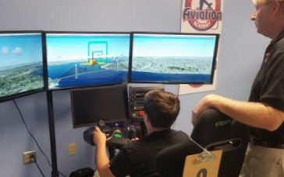




Aviation Academy
Denbigh High School

Slide 13

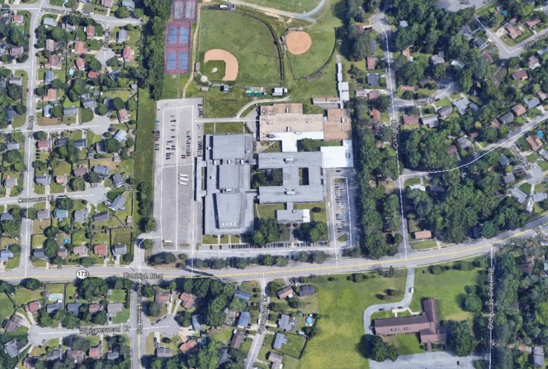
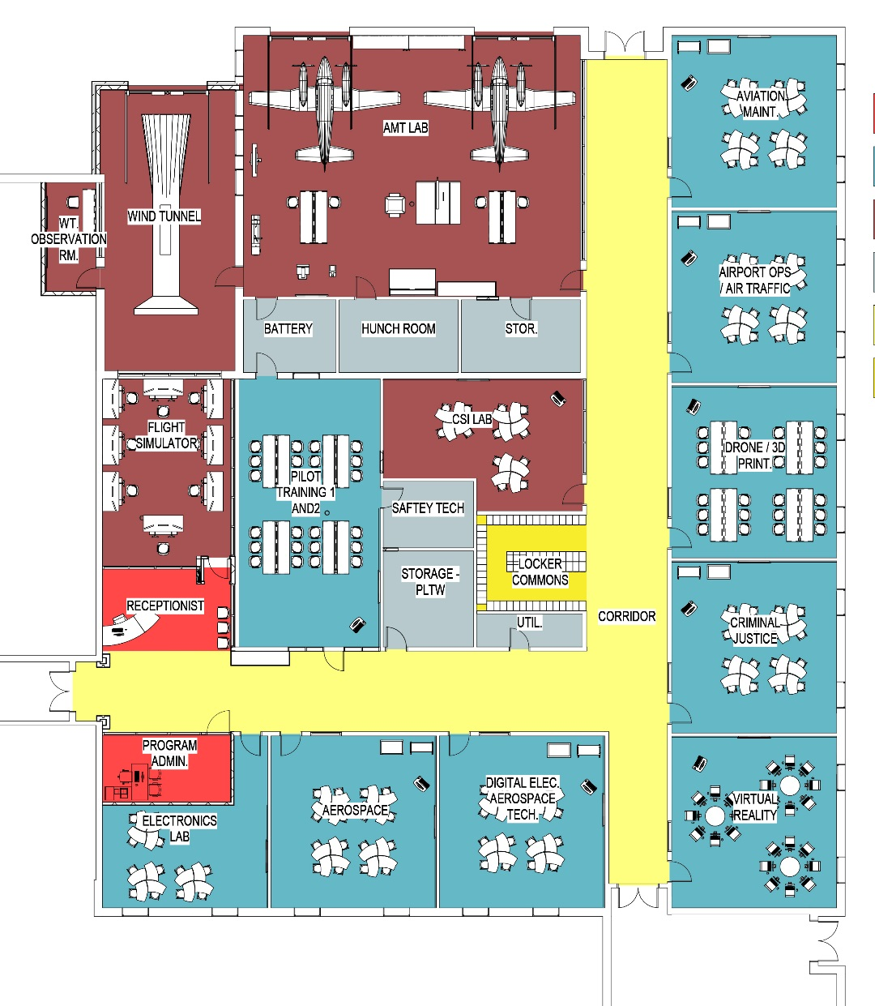
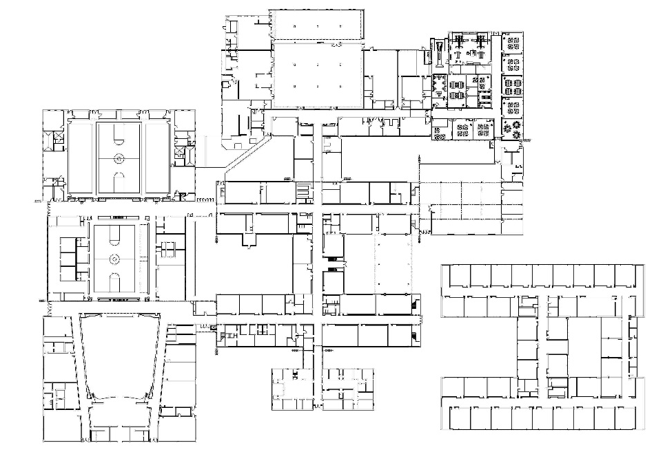
PM
AM
NOON
Denbigh H.S. Site Plan
Proposed Aviation Academy Floor Plan
Proposed Floor Plan
Existing Denbigh H.S. Floor Plan

Slide 14
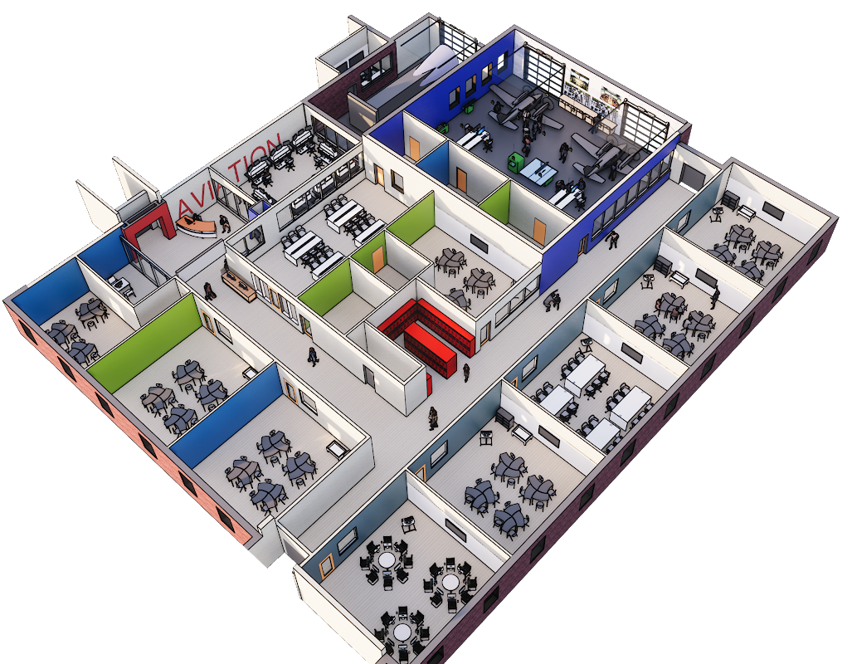
Proposed Floor Plan

Slide 15
What would need to be done at DHS?
Relocated classrooms can be accommodated in the building and in an 8-classroom modular unit
Ten classrooms to be relocated (Art -1, JROTC-1, SpEd-3, World Languages-5)
Provide eight-classroom modular unit
  Lease for 36 months - $346K
  Lease for 60 months - $529K
  Purchase - $550K
Other modifications needed to school
Create hallway to modular classrooms
Provide sidewalk and canopy
Provide accommodations for wind tunnel – roof, wind deflector wall
Create large exterior doorway in airframe lab
Relocate furniture and equipment (wind tunnel, turbines, airframes, toolboxes, etc.)

Slide 16
Next Steps
To ensure relocation for beginning of next school year:
      Order modular classrooms and begin necessary permitting process with city
      Complete design work
      Create scope of work to determine funding needs for construction
      Begin construction planning
      Schedule work for summer completion
Work with PAC to identify location at airport for future Aviation Academy
Work with city manager to identify private investment to fund facility construction

